Slide 1
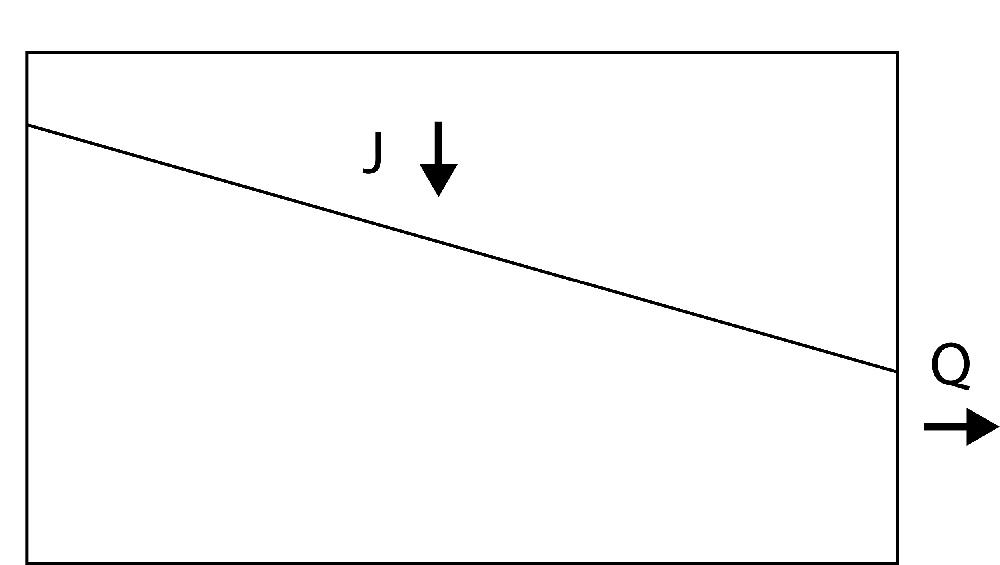
TRANSIT TIME DISTRIBUTION
Rainfall
Water particles in hillslope
Transit time frequency of
water particles in discharge
= Transit time distribution
p_{Q} [1/day]
Q
T [day]
Water particles in discharge
P_{Q} [-]
Cumulative
transit time distribution
Hillslope
T [day]
Notes:
As you can see, the discharging water is composed of diversely colored water, and the transit time distribution is very complicated and time-varying.
And it makes parameterizing the transit time distribution very difficult.

